Slide 1
Regression Analysis
Model Selection
Nicoleta Serban, Ph.D.
Professor
Stewart School of Industrial and Systems Engineering
Prediction Risk Estimation

Slide 2

About This Lesson

Slide 3
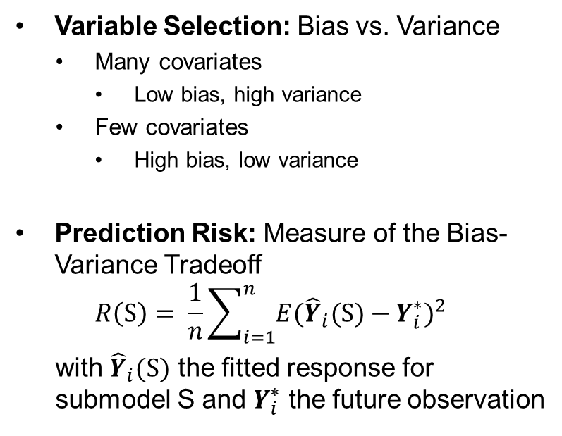
Bias-Variance Tradeoff
Variable Selection: Bias vs. Variance
  Many covariates
    Low bias, high variance
  Few covariates
    High bias, low variance
Prediction Risk: Measure of the Bias-Variance Tradeoff
$$R\left(S\right)= \frac{1}{n}\sum_{i=1}^{n}{E{({\hat{Y}}_{i}(S)−Y_{i}^{∗})}^{2}}$$
with ${\hat{Y}}_{i}(S)$ the fitted response for submodel S and $Y_{i}^{∗}$ the future observation
We cannot obtain the prediction risk because we do not have the future observations.
How to estimate?

Slide 4
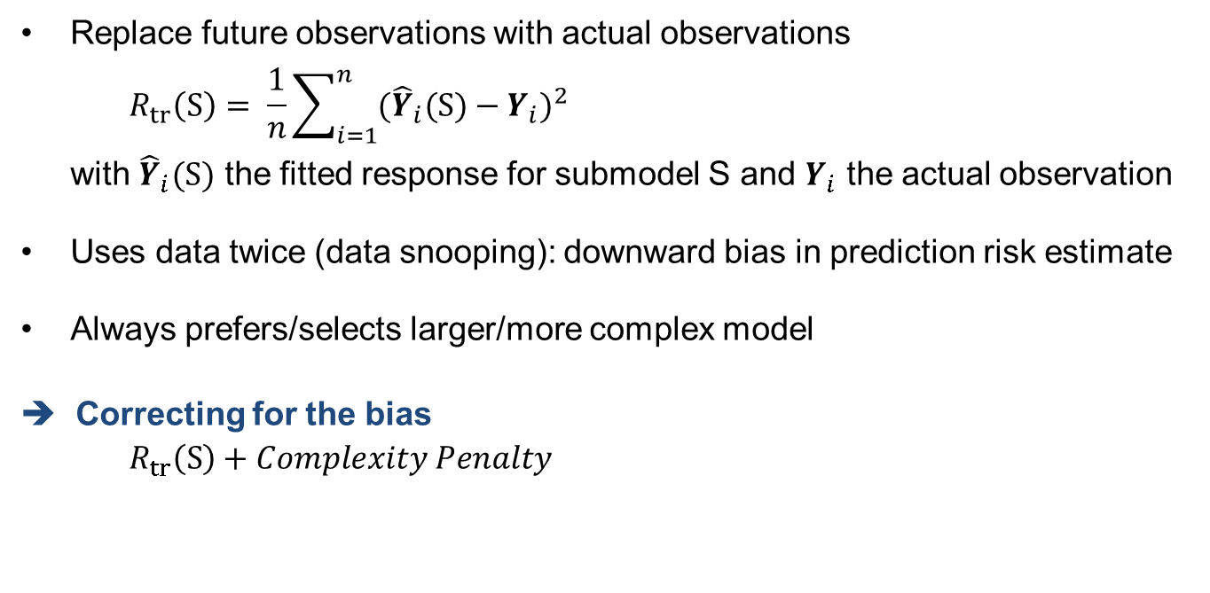
Training Risk
Replace future observations with actual observations
$$R_{tr}\left(S\right)= \frac{1}{n}\sum_{i=1}^{n}{{({\hat{Y}}_{i}(S)−Y_{i})}^{2}}$$
with ${\hat{Y}}_{i}(S)$ the fitted response for submodel S and $Y_{i}$ the actual observation
Uses data twice (data snooping): downward bias in prediction risk estimate
Always prefers/selects larger/more complex model
➔ Correcting for the bias
  $$R_{tr}\left(S\right)+Complexity Penalty$$

Slide 5
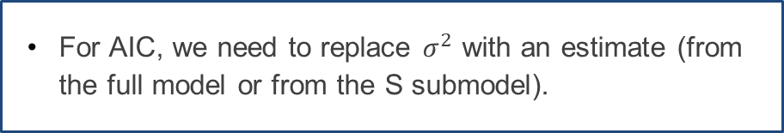
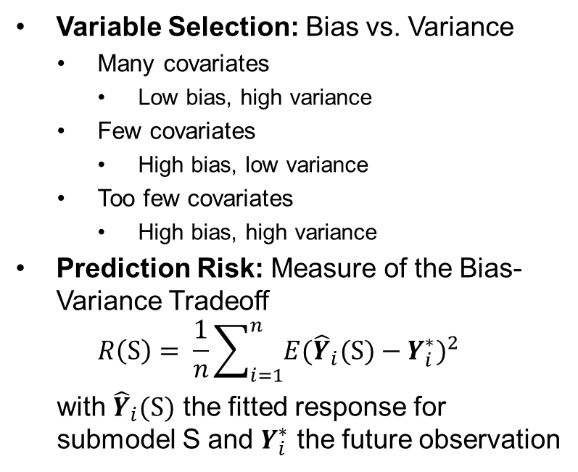
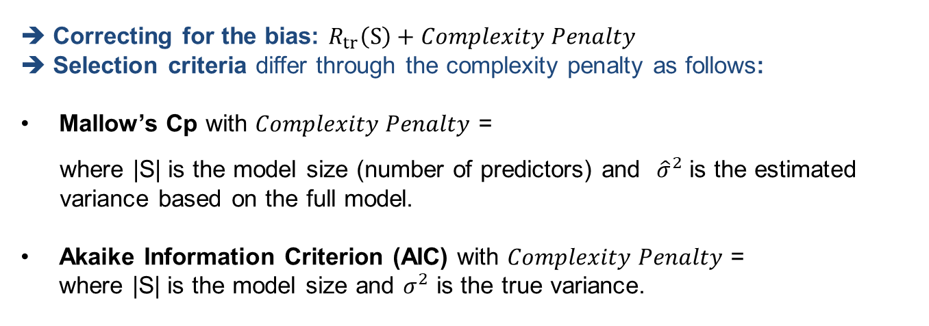
Variable Selection Criteria
Correcting for the bias: $R_{tr}\left(S\right)+Complexity Penalty$
Selection criteria differ through the complexity penalty as follows:
Mallow’s Cp with $Complexity Penalty$ =
where |S| is the model size (number of predictors) and ${\hat{σ}}^{2}$ is the estimated variance based on the full model.
Akaike Information Criterion (AIC) with $Complexity Penalty$ =
where |S| is the model size and $σ^{2}$ is the true variance.
$$\frac{2|S|{\hat{σ}}^{2}}{n}$$
$$\frac{2|S|σ^{2}}{n}$$
For AIC, we need to replace $σ^{2}$ with an estimate (from the full model or from the S submodel).

Slide 6
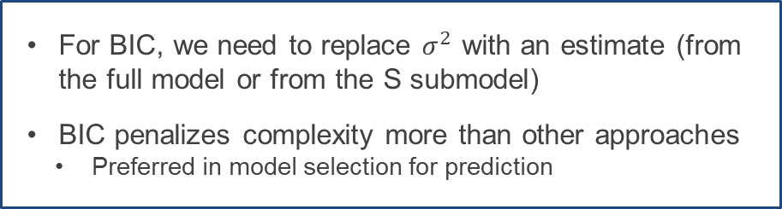
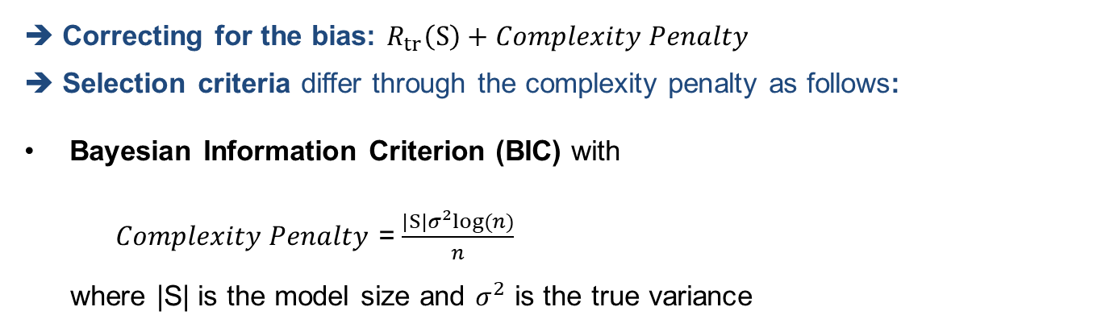
Variable Selection Criteria (cont’d)
Correcting for the bias: $R_{tr}\left(S\right)+Complexity Penalty$
Selection criteria differ through the complexity penalty as follows:
Bayesian Information Criterion (BIC) with
$Complexity Penalty$ = $\frac{|S|σ^{2}log⁡(n)}{n}$
where |S| is the model size and $σ^{2}$ is the true variance
For BIC, we need to replace $σ^{2}$ with an estimate (from the full model or from the S submodel)
BIC penalizes complexity more than other approaches
  Preferred in model selection for prediction

Slide 7
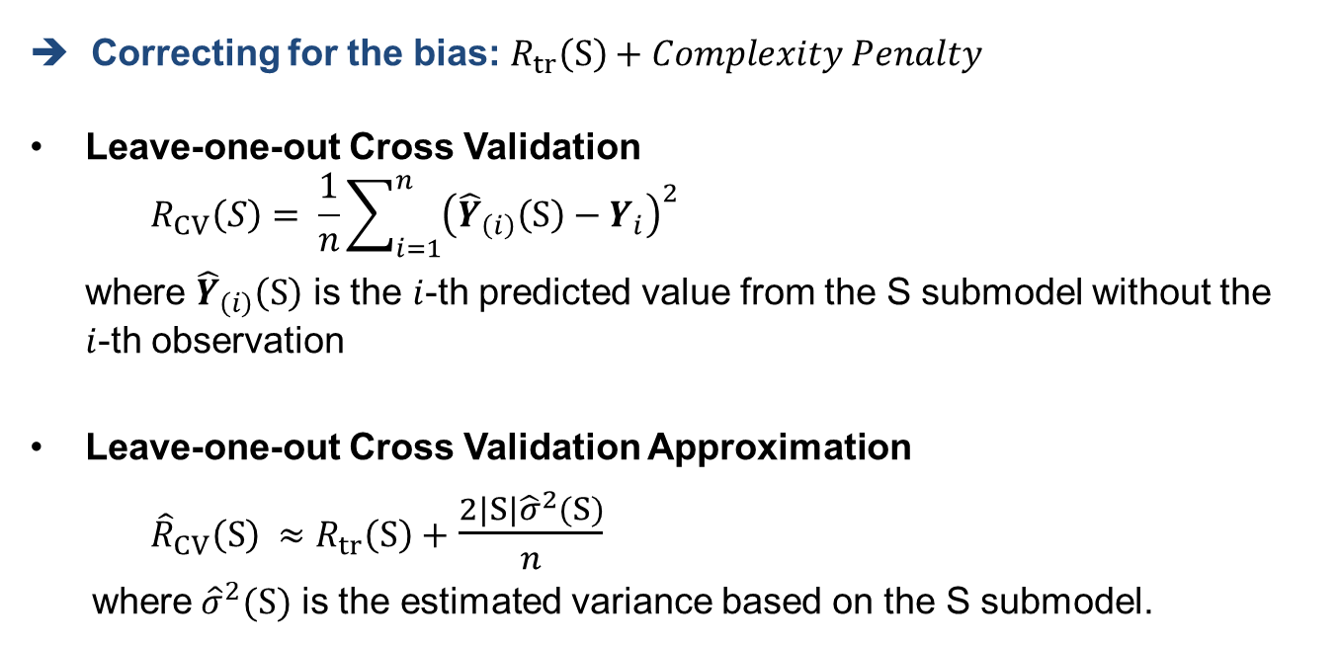
Variable Selection Criteria (cont’d)
➔ Correcting for the bias: $R_{tr}\left(S\right)+Complexity Penalty$
Leave-one-out Cross Validation
$$R_{CV}\left(S\right)= \frac{1}{n}\sum_{i=1}^{n}{{\left({\hat{Y}}_{\left(i\right)}\left(S\right)−Y_{i}\right)}^{2}}$$
where ${\hat{Y}}_{\left(i\right)}\left(S\right)$ is the $i$-th predicted value from the S submodel without the
$i$-th observation
Leave-one-out Cross Validation Approximation
${\hat{R}}_{CV}\left(S\right) ≈R_{tr}\left(S\right)+$ $\frac{2|S|{\hat{σ}}^{2}(S)}{n}$
where ${\hat{σ}}^{2}(S)$ is the estimated variance based on the S submodel.

Slide 8
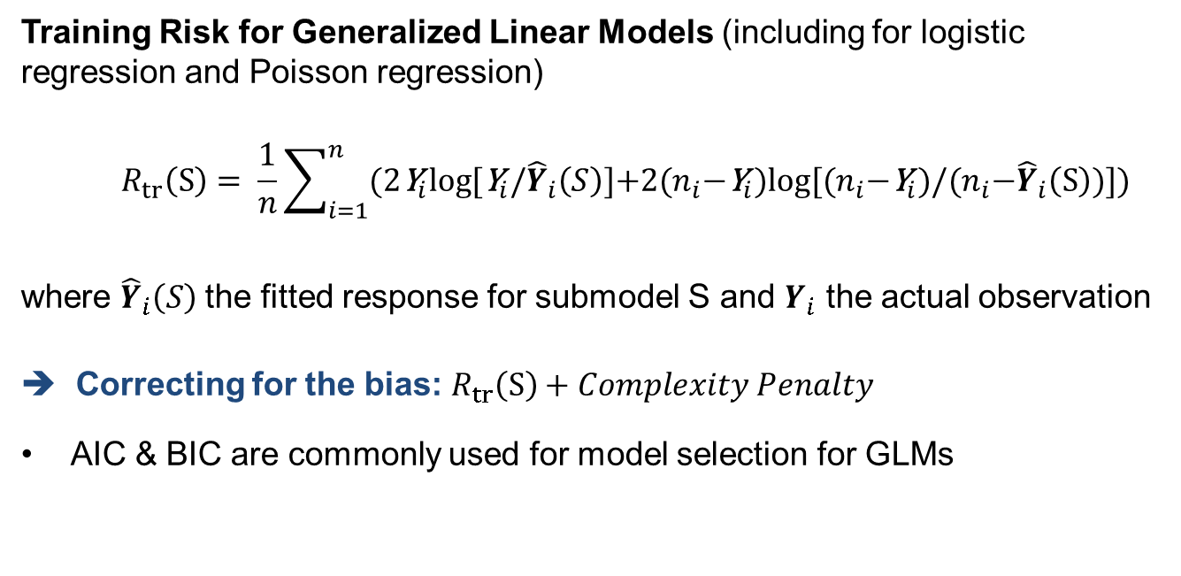
Generalized Linear Models
Training Risk for Generalized Linear Models (including for logistic regression and Poisson regression)
$$R_{tr}\left(S\right)= \frac{1}{n}\sum_{i=1}^{n}{\text{(}\text{2}{\text{Y}}_{i}\text{log}⁡[{\text{Y}}_{i}\text{/}{\hat{Y}}_{i}\left(S\right)\text{]+2(}n_{i}\text{−}{\text{Y}}_{i})\text{log}⁡[{(n}_{i}\text{−}{\text{Y}}_{i})\text{/}\text{(}n_{i}\text{−}{\hat{Y}}_{i}\left(S\right))\text{])}}$$
where ${\hat{Y}}_{i}\left(S\right)$the fitted response for submodel S and $Y_{i}$ the actual observation
➔ Correcting for the bias: $R_{tr}\left(S\right)+Complexity Penalty$
AIC & BIC are commonly used for model selection for GLMs

Slide 9
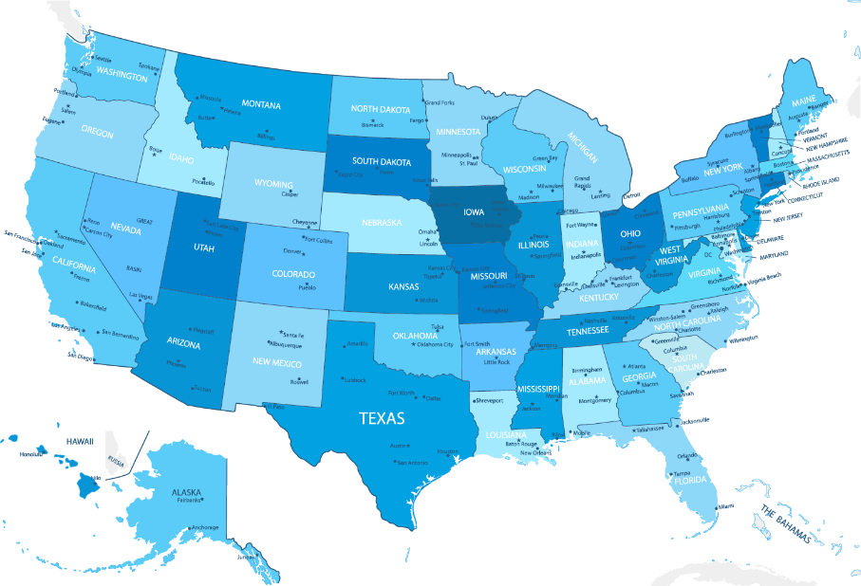
Ranking States by SAT Performance
Which variables are associated with state average SAT scores?
After accounting for selection biases, how do the states rank?
Which states perform best for the amount of money they spend?
SAT Mean Score by State – Year 1982
790 (South Carolina) – 1088 (Iowa)

Slide 10
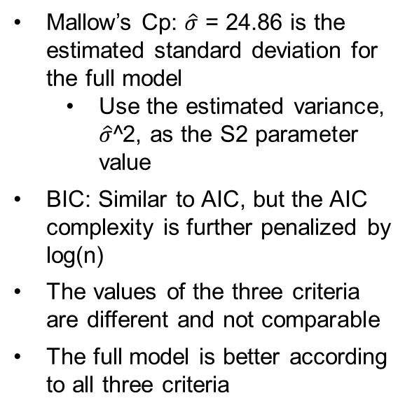
Model Selection Criteria Using R
library(CombMSC)
n = nrow(datasat)
## full model
c(Cp(regression.line, S2=summary(regression.line)$sigma^2),
AIC(regression.line, k=2), AIC(regression.line, k=log(n)))
[1] 7.016756 471.698197 486.994381
## reduced model
c(Cp(regression.red, S2=summary(regression.line)$sigma^2),
AIC(regression.red, k=2), AIC(regression.red, k=log(n)))
[1] 29.67045 490.59880 498.24689
Mallow’s Cp: $\hat{σ}$ = 24.86 is the estimated standard deviation for the full model
  Use the estimated variance, $\hat{σ}$^2, as the S2 parameter value
BIC: Similar to AIC, but the AIC complexity is further penalized by log(n)
The values of the three criteria are different and not comparable
The full model is better according to all three criteria

Slide 11

Summary

